Slide 1
Triple Rule Out Review
Rafael Montero
EU Clinical Training Leader Computed Tomography
Special Acknowledgement to the Diagnositc Imaging Department at Hospital QuironSalud Madrid

Slide 2
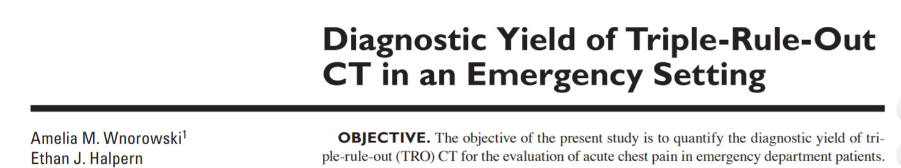
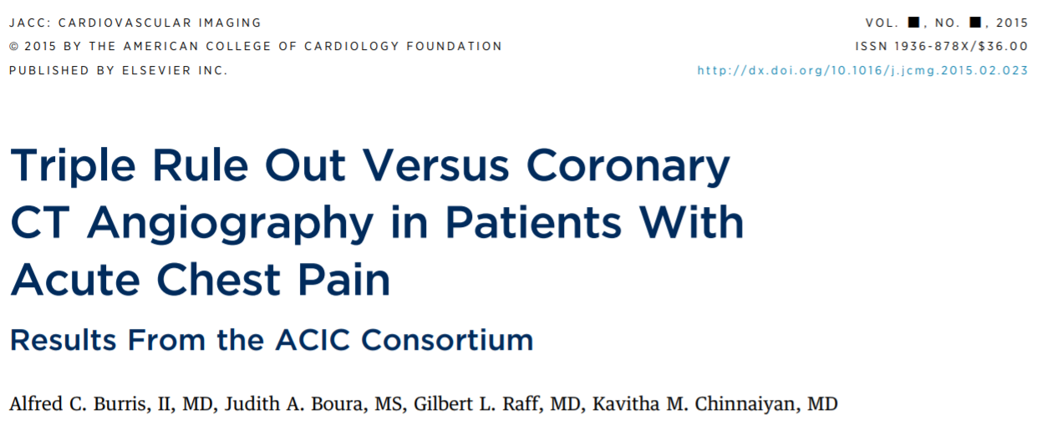
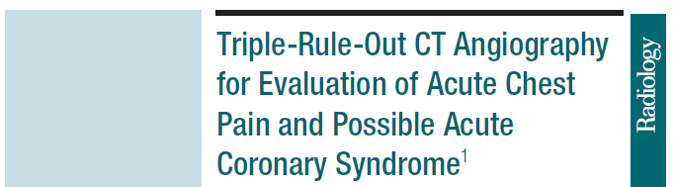
Background
This is just a quick Introduction, for more details please review the bibliography
(http://dx.doi.org/10.2214/AJR.15.15717)
http://dx.doi.org/10.1016/j.jcmg.2015.02.023
10.1148/radiol.2522082335

Slide 3
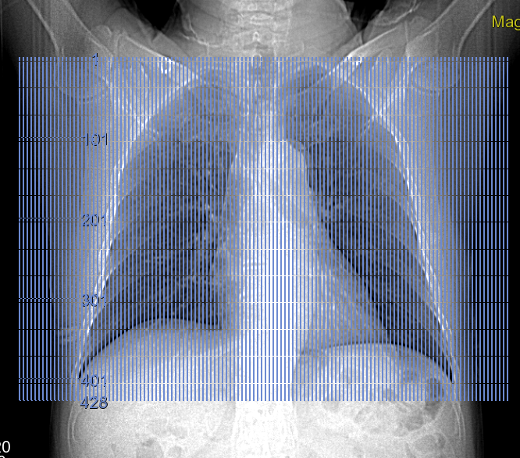
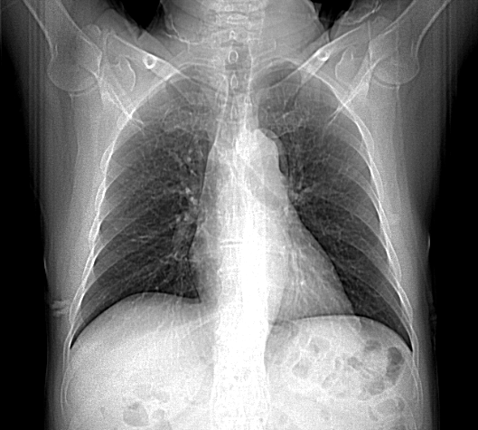
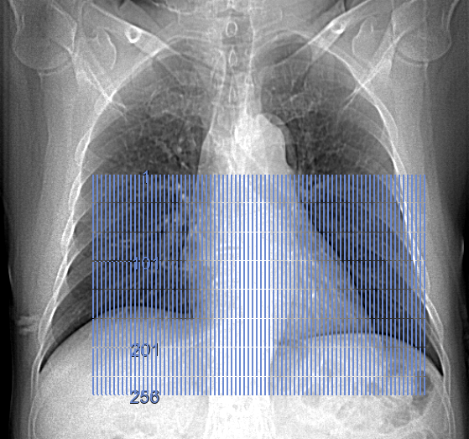
Triple Rule Out
Triple rule out is an emergency cardiac exam that seeks to exclude the 3 main sources of acute chest pain and dyspnoea: Pulmonary Embolysm, Coronary Artery Disease and Acute Aortic Syndrom.
In terms of acquisition range, gating, patient prep etc... there´s no difference with a Bypass or Aorta + Coronaries acquisition, being the difference mainly on the injection.
For acquisition purposes do whatever your preference is for a Bypass or Coronary exam, both in terms of acquisition parameters and triggering, some users, especially in 40 mm systems, acquire Inferior to superior to image the coronaries first and avoid HR changes or respiratory artifacts more likely to happen at the end of the scan.... Rest of parameters identical.
Acq range (Whole chest)
Acq range (Adjusted to CVascular)
Reconstruction range for detailed coronary assessment

Slide 4
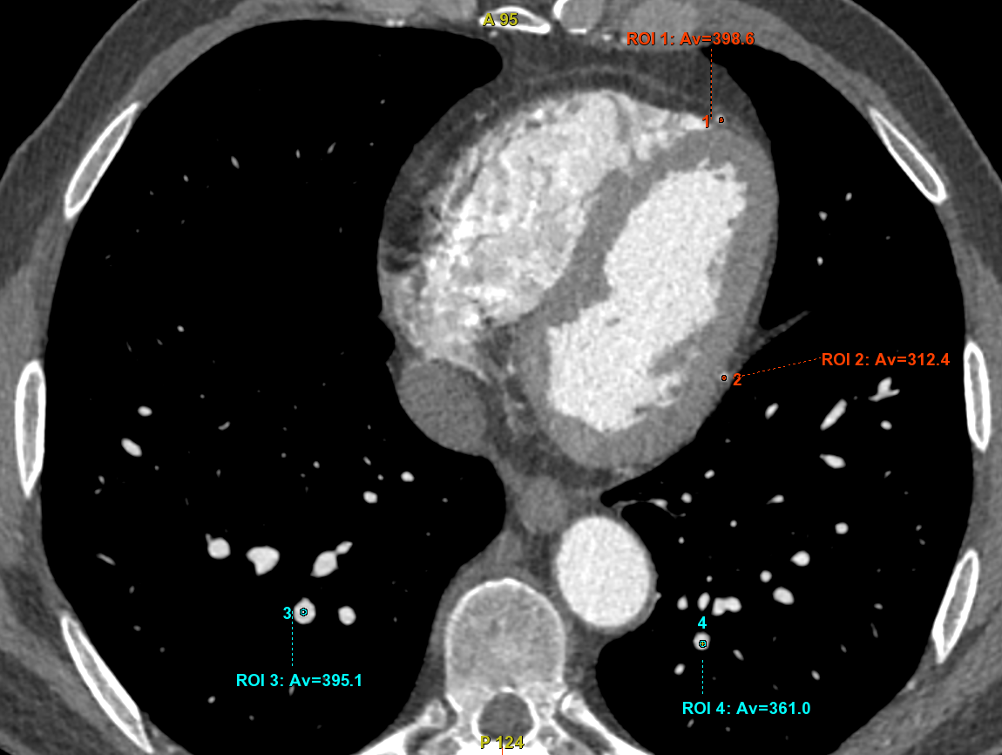
Triple Rule Out
1*
Radiology: Volume 252: Number 2—August 2009
Main change is in the Injection, where besides getting good Aortic and coronary contrast (>300 HU)(1*) we have 2 main goals:
Maintain sufficient enhancement in the pulmonary arteries (> 200 HU) (1*)
Avoid excessive artifacts from the right cavities to the RCA.
If the Injector has the possibility to dilute, use whatever you inject for a bypass exam and replace the Saline by 40-50 ml of diluted contrast (50%) at the same injection rate.
If the injector has no possibility to dilute you may reduce injection rate, especially for the saline flush
With dilution:
40 mm system: 70-80 ml C @ 5 ml/s + 50 ml diluted C (50%) @ 5 ml/s
REV CT: 60 ml C @ 5ml/s + 40 ml diluted @ 5 ml/s
Without dilution:
Lower flow, lower strength:
70 ml C @ 5 ml/s + 30 ml C @ 3 ml/s + 30 ml SF @ 3 ml/s
If longer coverage is needed increase the 1st phase injection accordingly
Trigger as usual in your institution for Bypass exams

Slide 5
Protocol example

Slide 6
Protocol for Revolution CT (16 cm) as used by Hospital QuironSalud Madrid
Scouts
Non Contrast Gated CT (optional)
CT Gated Angiography Acquisition
Coronary Optimal phase selection
Reconstruction of whole anatomy and cardiac dedicated volumes at optimal phase
This protocol reflects this department´s preference and experience, please review both scan and injection parameters to adapt it to your department´s injection, IQ and dose policies.
Acquisition
Reconstruction

Slide 7
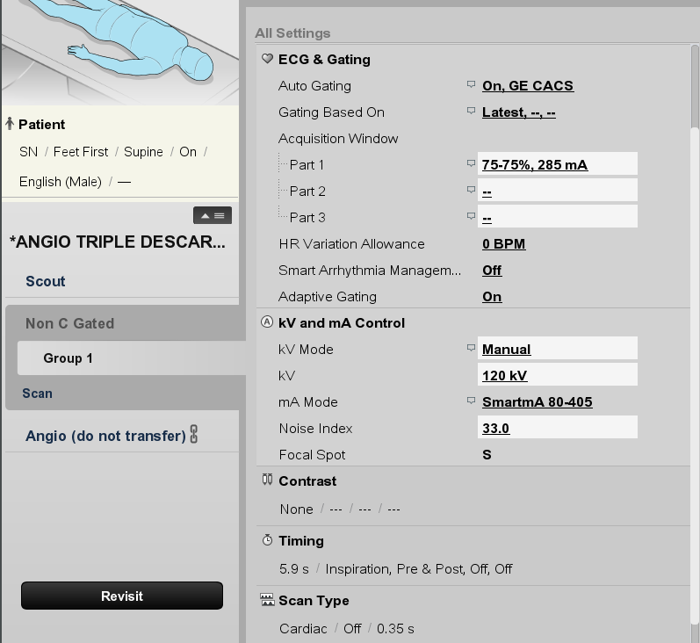
Non contrast Gated Acquisition
Non Contrast CT for the evaluation of Aortic mural thrombus and other pathologies. We use Gated acquisition for non-c because there´s no dose penalty and we avoid pulsatile artifact
Calcium Score Auto Gating profile
120 kVp just in case you wish to use Smart Score sw and to have better SNR in bigger patients
Adjust ASiR-V and dose to your preferences.
0.35 s Rot for more mAs in bigger patients

Slide 8
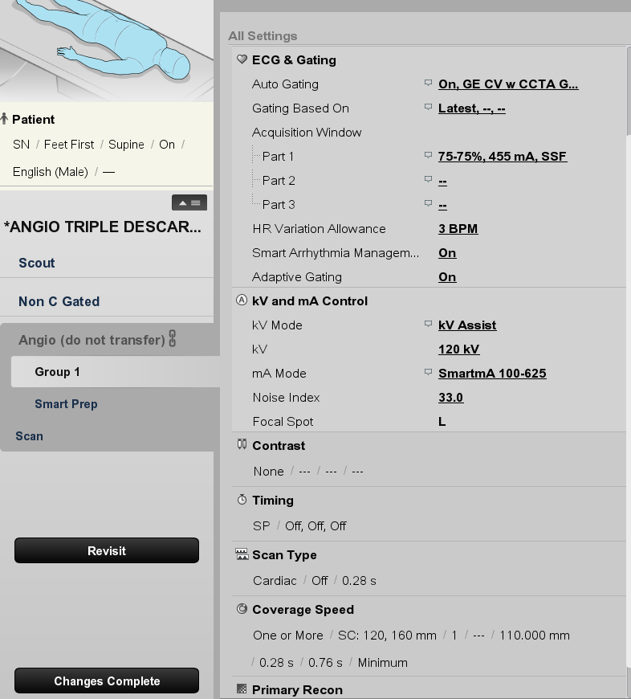
Gated Aorta and coronaries
We use as a base the Bypass protocol
CV w CCTA Group Auto Gating profile chosen due to better selection of Adaptive Gating and SAM, but CCTA also ok.
User CCTA parameters
ASiR-v etc per customer preferences

Slide 9
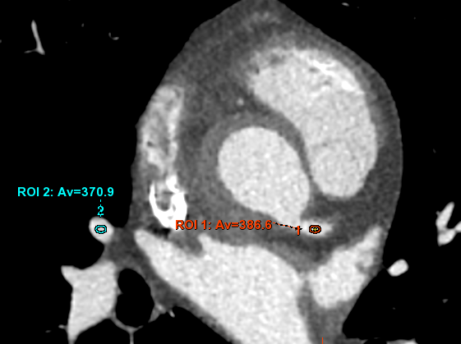
Injection protocol:
Goals:
Reach optimum enhancement of Aorta and coronaries (> 300 HU)
Maintain sufficient enhancement in the pulmonary arteries (> 200 HU)
Avoid excessive artifacts from the right cavities to the RCA.
Avoid PA washout
Protocol:
65 cc C @ 5 cc/s
50 cc diluted contast 50 % @ 5 cc/s (25 cc C + 25 cc SF)
No Saline Flush

Slide 10
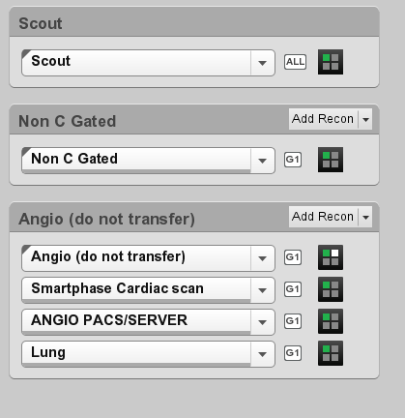
Reconstruction:
Only for image review
Provides coronary-dedicated volume and phase for R3
For all anatomy evaluation, with optimized phase and Recon Mode plus

Slide 11
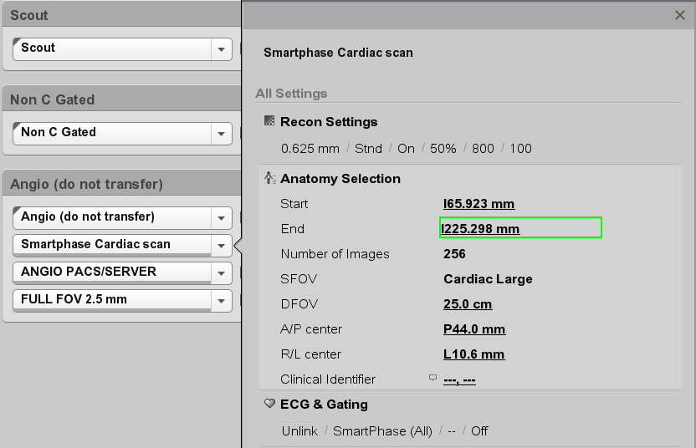
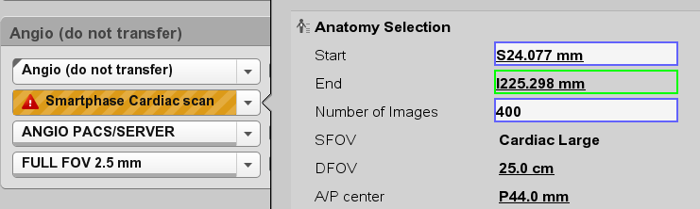
Optimal phase not selected, Recon mode plus not enabled used just for image review.
With SmartPhase make sure you select just one anatomy (cardiac), otherwise system will report the below error
SmartPhase all in case more than one Acq window is selected
If SmartPhase available, otherwise earliest to latest and visual assessment.

Slide 12
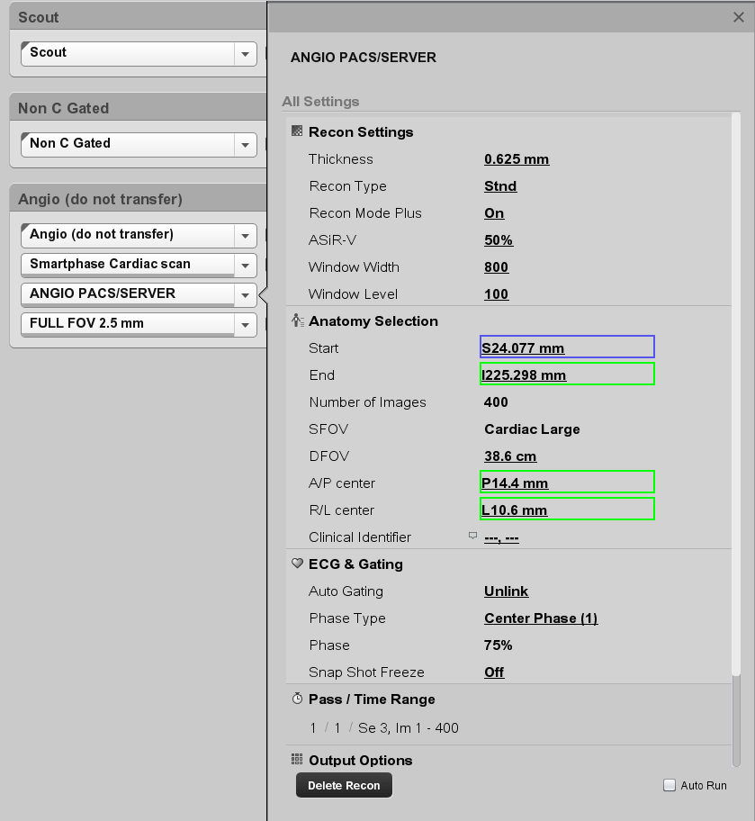
For enhanced binding of scans
Radiographer changes to manual Single phase and inputs best phase obtained at recon 2 ( SmartPhase or visually assessed)
Off to allow Radiographer input of phase

Slide 13
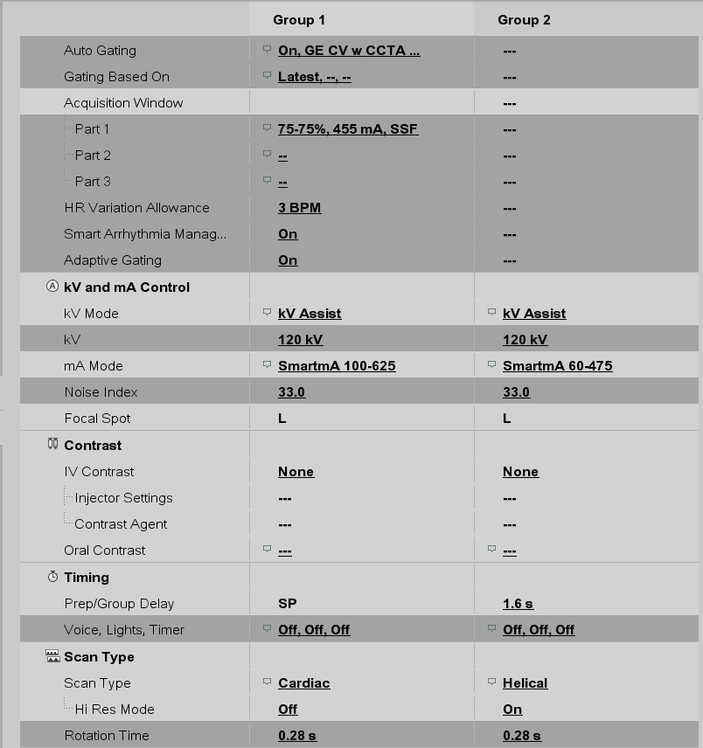
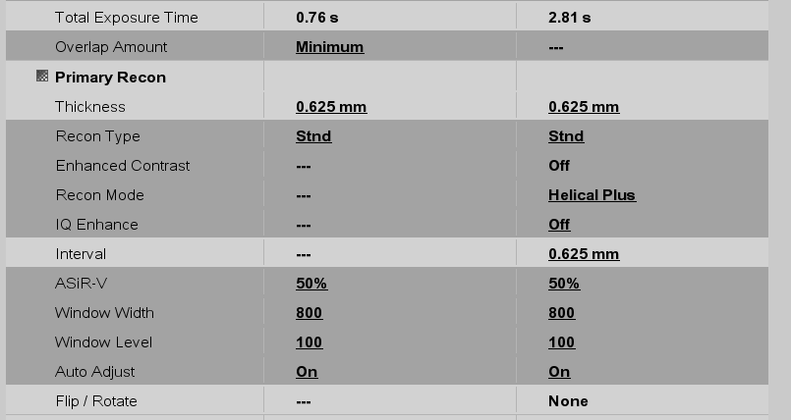
Additional protocol Including Abdominal Aorta group

Slide 14
Clinical case

Slide 15
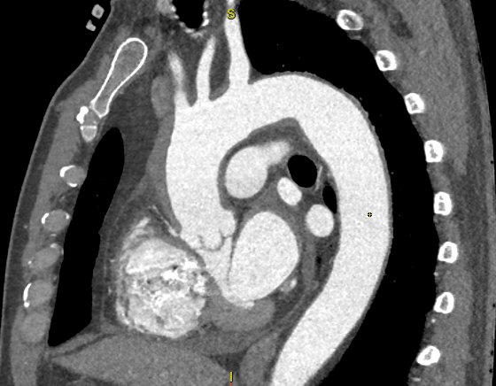
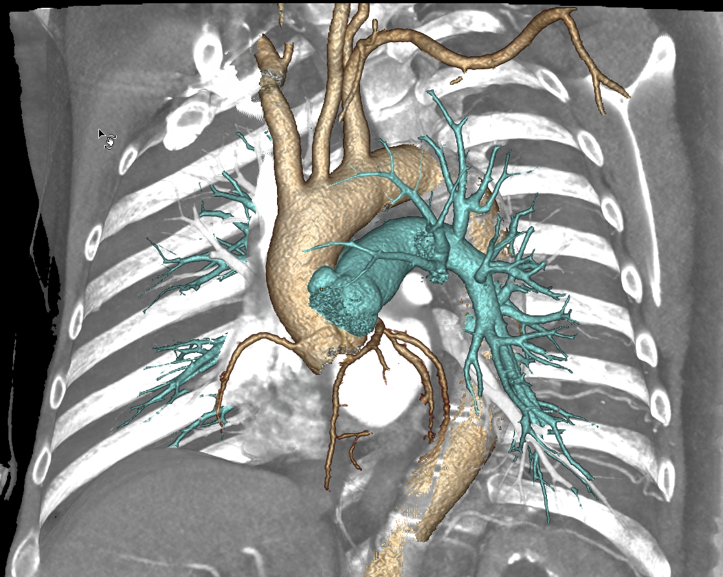
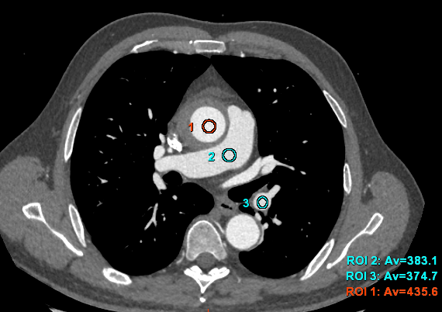
Triple Rule Out
IMAGES COURTESY OF HOSPITAL UNIVERSITARIO QUIRONSALUD MADRID, DR. MARTÍNEZ DE VEGA, SPAIN
Scan type | WCC 120 + 160 mm
Rotation time, s | 0.28
Gating | Auto gating
Slice, mm | 0.625
kV | 100
mA | SmartmA
Noise index | 35
Kernel | Std
ASiR-V, % | 50
CTDIvol, mGy DLP mGy x cm | 6.82 160.31
HR | Variable 63-74 bpm
BMI | 28
Contrast | 350 mg/ml 50 cc C @ 5 cc/s + 50 cc Dilution 50% @ 5 cc/s
History: Patient admitted to emergency for chest pain and dyspnoea, no ECG alterations, Cardiac US shows aortic mural hematoma (arrowheads), referred to Imaging for Triple rule out.
Excellent Uniformity of Aorta
VR
Notes:
)

Slide 16
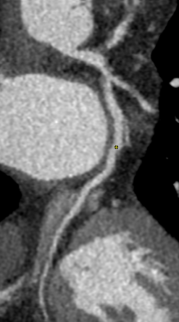
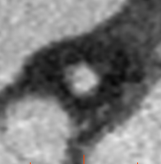
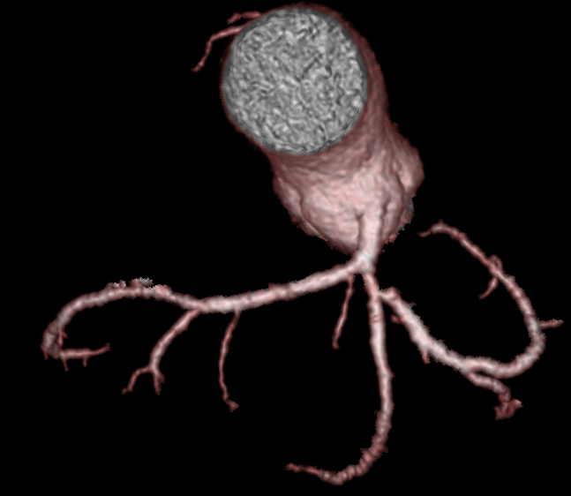
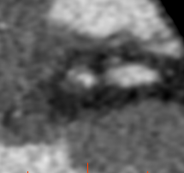
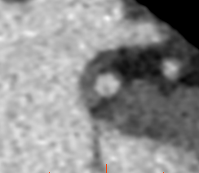
Coronary assessment
IMAGES COURTESY OF HOSPITAL UNIVERSITARIO QUIRONSALUD MADRID, DR. MARTÍNEZ DE VEGA, SPAIN
SmartPhase 77% R-R
Scan type | WCC 120 + 160 mm
Rotation time, s | 0.28
Gating | Auto gating
Slice, mm | 0.625
kV | 100
mA | SmartmA
Noise index | 35
Kernel | Std
ASiR-V, % | 50
CTDIvol, mGy DLP mGy x cm | 6.82 160.31
HR | Variable 63-74 bpm
BMI | 28
Contrast | 350 mg/ml 50 cc C @ 5 cc/s + 50 cc Dilution 50% @ 5 cc/s
Findings: No PE or dissection, significant stenosis due to soft plaque at origin of dominant LCX artery.
1
1
2
3
2
3
VR

Slide 17
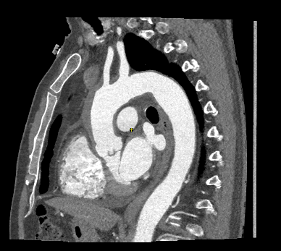
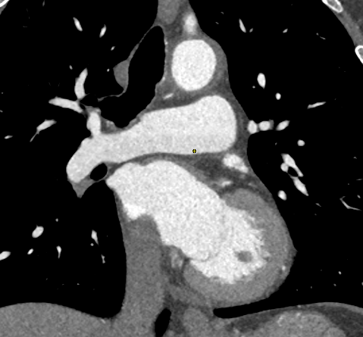
Contrast evaluation
IMAGES COURTESY OF HOSPITAL UNIVERSITARIO QUIRONSALUD MADRID, DR. MARTÍNEZ DE VEGA, SPAIN
Contrast in distal Coronary Arteries > 300 HU
Contrast in distal Pulmonary Arteries > 200 HU
Good Contrast Uniformity across entire volume
Contrast gradient/breathing line minimizesd by Recon Mode plus

